Slide 1


CMS ttX Round-table Status Report National Technical University of Athens
K. Kousouris, G. Tsipolitis, G. Bakas, I. Papakrivopoulos

Slide 2
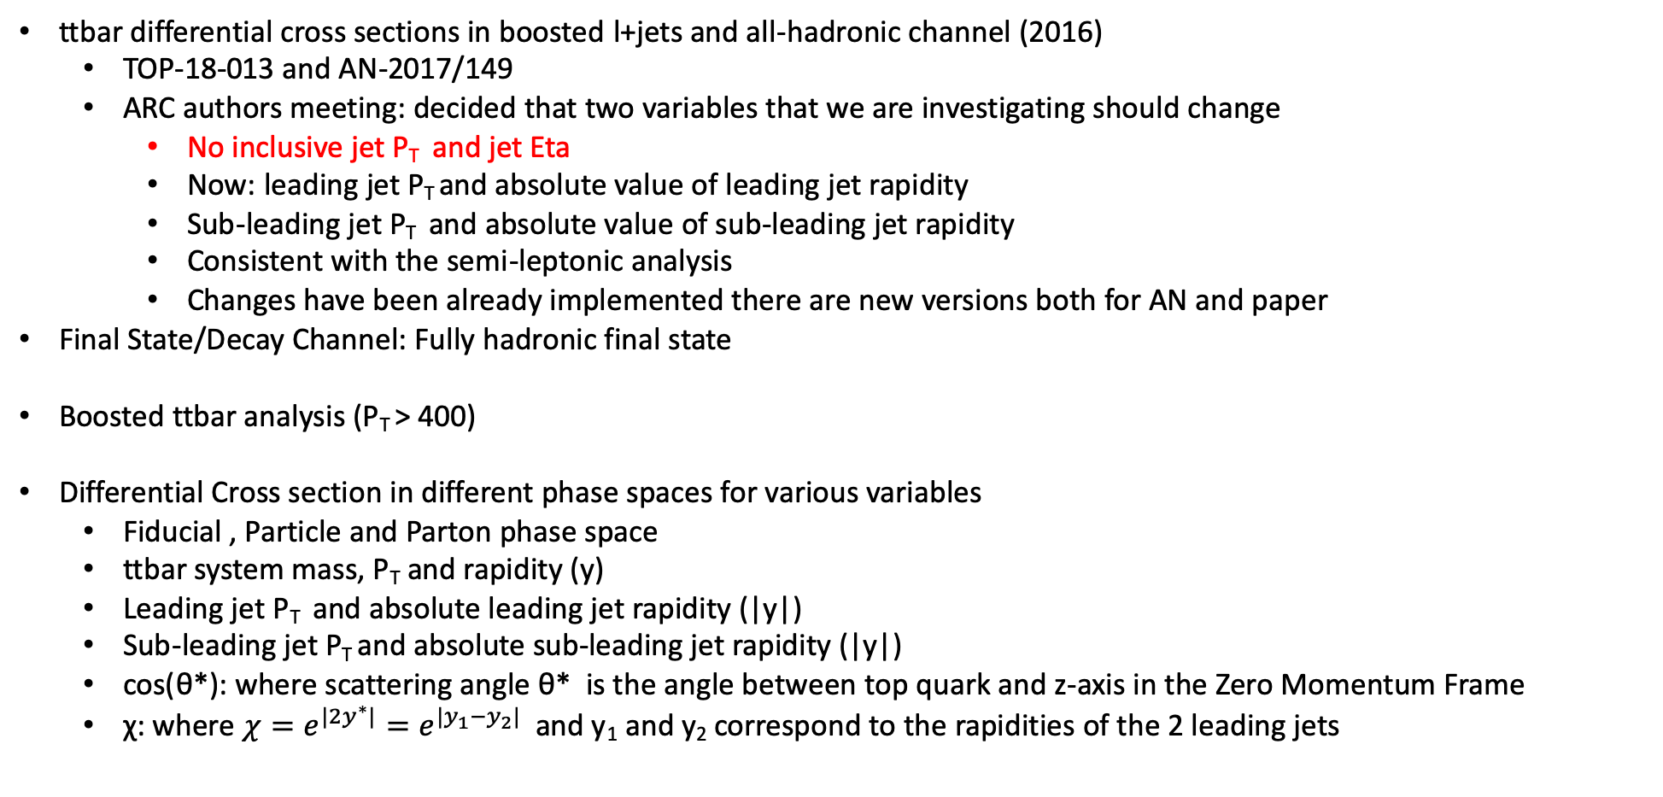
Status
ttbar differential cross sections in boosted l+jets and all-hadronic channel (2016)
TOP-18-013 and AN-2017/149
ARC authors meeting: decided that two variables that we are investigating should change
No inclusive jet P_{T} and jet Eta
Now: leading jet P_{T} and absolute value of leading jet rapidity
Sub-leading jet P_{T} and absolute value of sub-leading jet rapidity
Consistent with the semi-leptonic analysis
Changes have been already implemented there are new versions both for AN and paper
Final State/Decay Channel: Fully hadronic final state
Boosted ttbar analysis (P_{T} > 400)
Differential Cross section in different phase spaces for various variables
Fiducial , Particle and Parton phase space
ttbar system mass, P_{T} and rapidity (y)
Leading jet P_{T} and absolute leading jet rapidity (|y|)
Sub-leading jet P_{T} and absolute sub-leading jet rapidity (|y|)
cos(θ*): where scattering angle θ* is the angle between top quark and z-axis in the Zero Momentum Frame
χ: where $χ=e^{{|2y}^{∗}|}=e^{|y_{1}−y_{2}|}$ and y₁ and y₂ correspond to the rapidities of the 2 leading jets

Slide 3
Status
Looking into:
2016: 9_4_XX re-reco
2017: 9_4_XX
2018: 10_2_XX
2016 and 2017 data
We are using only the TT bar samples with the Mtt cut (both 700-1000GeV and 1000-Inf GeV samples)
New “top Tagger” that discriminates top jet candidates and QCD multijet background jets
The new tagger is trained per jet and not per event
3 separate trainings for each year (2016, 2017, 2018)
Efficiencies and acceptances for all variables for the 3 separate years
We have decided on 3 different Working Points for our tagger in order for the Efficiency of the leading jet P_{T} to be si similar in all 3 years
Response matrices for all variables and for every year accordingly
In agreement with other analysis as well as uknown CSVv2 Working Points for the 2018 MC , we are using the deepCSV b-tagger and not the CSVv2.
The deepCSV tagger is more efficient than the CSVv2 in our analysis
Extract QCD background shape from data

Slide 4
Future Steps
Proceed with the fit for the QCD bkg extraction, extract the signal S(x) where x is each contemplated variable
Unfold to the Particle and Parton Phase spaces for each variable
Neural Network instead of BDT
MC variations
Ultra legacy file

